Slide 1

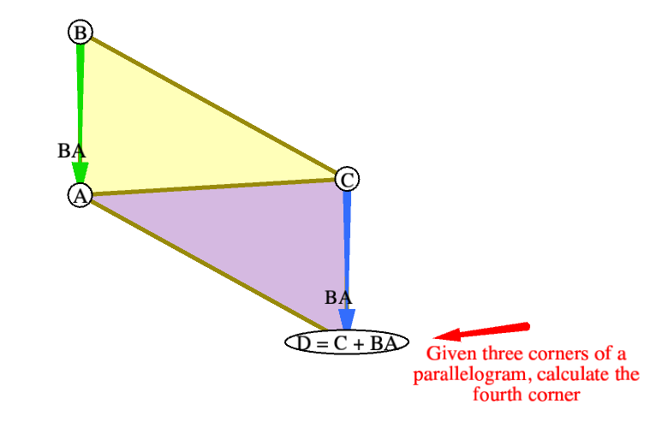
Playing with POINTS AND VECTORS
CS3451 FALL 2020
Saumya JAIN

Slide 2
PHSE 1: Problem statement
Given three points (A, B, C), find a fourth point D so that the set of points {A,B,C,D} makes up the corner points of a parallelogram.
COMMENTS:
In order to accurately calculate the fourth point, we assume the following:
The initial points (A, B, C) are not colinear.
The set of points {A, B, C, D} are ordered clockwise or anticlockwise around the parallelogram.
Here, there can be 3 possible parallelograms, but I have chosen to make the one with edge AC as common between the two halves. This is for simplicity.

Slide 3
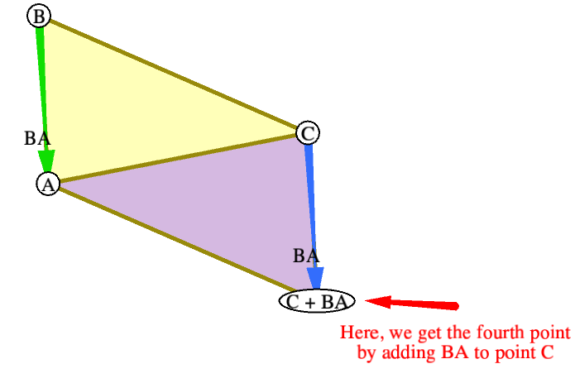
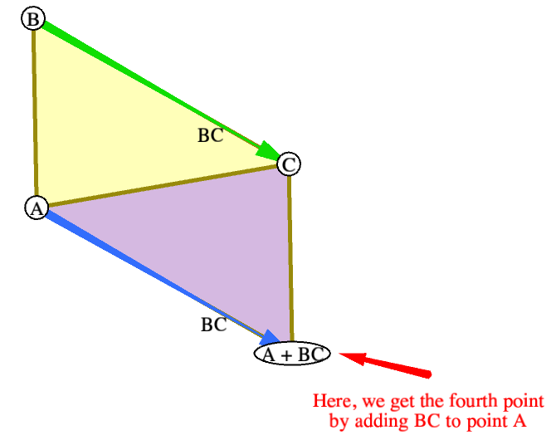
PHSE 1: Solution outline
We can compute the required point D using a point plus vector approach. We need to pick point A or C and add the vector which is between the other two points. This vector will be equal to the required vector to finish the parallelogram.

Slide 4
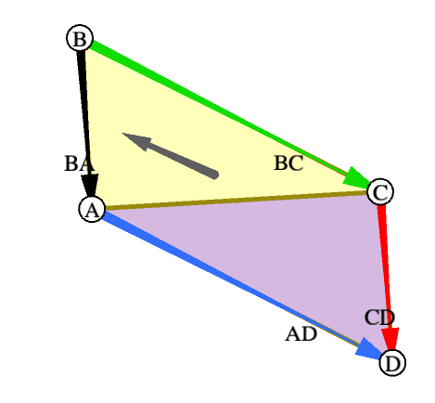
PHSE 1: Solution math
D = A + BC = C + BA
JUSTIFICATION:
We know the following:
In a parallelogram with points A, B, C, D, we have vector equality AD = BC
In a parallelogram with points A, B, C, D, we have vector equality BA = CD.
Hence, we get:
D – A = BC => D = A + BC
D – C = BA => D = C + BA

Slide 5
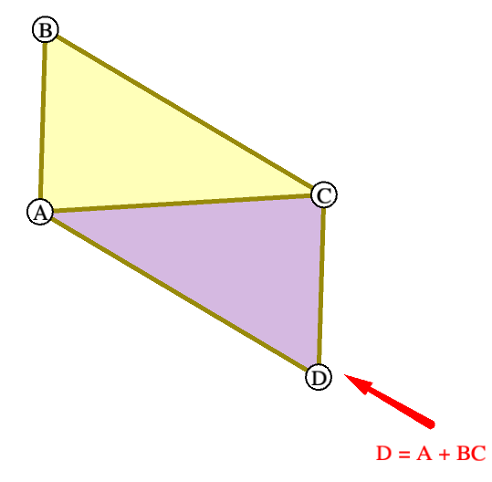
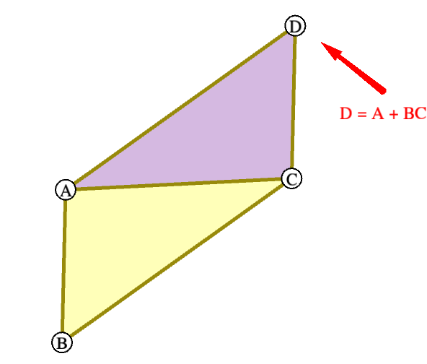
PHSE 1: Solution examples and limitations
My solutions works for clockwise and counterclockwise orientations of the initial points A, B, C

Slide 6
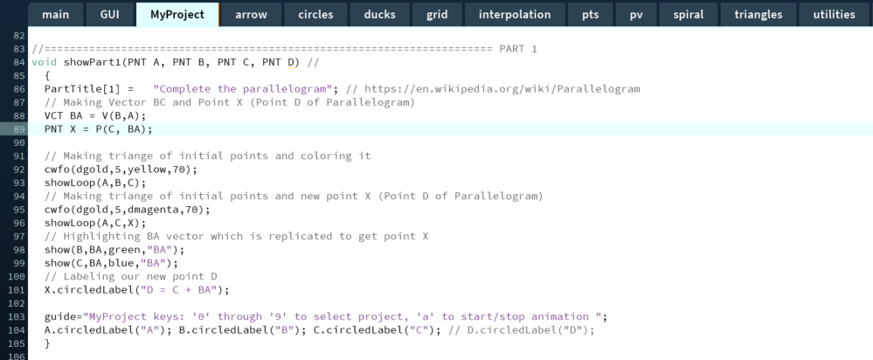
PHSE 1: Code

Slide 7
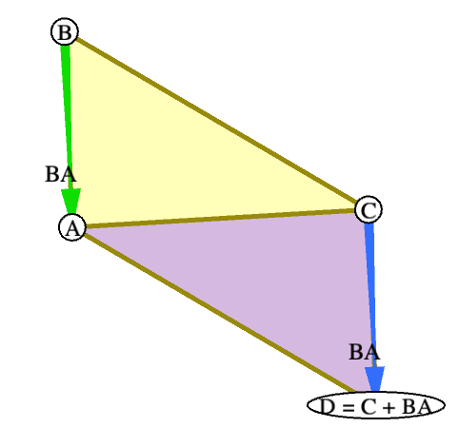
PHSE 1: Code
The code from the previous slide outputs the following:

Slide 8
PHSE 1: Sources
My solution is based on my own previous knowledge of parallelograms. In a parallelogram with points A, B, C, D, we have AD = BC and BA = CD.
This is derived from the following statements:
Opposite sides are parallel.
Opposite sides are equal in length.’
I found this information on Math is Fun at https://www.mathsisfun.com/geometry/parallelogram.html

Slide 9
PHSE 2: Problem statement
Given a triangle made of three points (A, B, C), find the point such that the total distance from the three vertices of the triangle to the point is the minimum possible. This will be the Fermat Point X.
COMMENTS:
In order to accurately calculate the Fermat point, we assume the following:
The initial points (A, B, C) form a triangle.
The set of points {A, B, C} are ordered clockwise or anticlockwise around the triangle.
No angle in triangle ABC is moe than 120 degrees (2π/3 radians)
Here, there is no ambiguity.

Slide 10
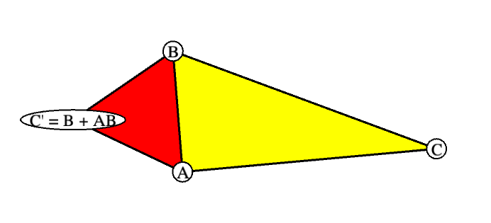
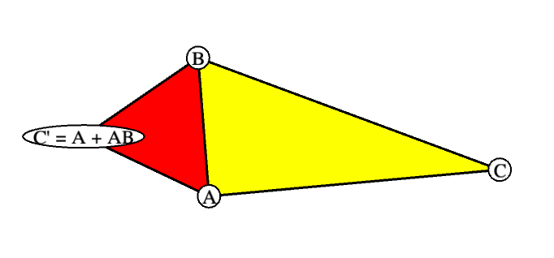
PHSE 2: Solution outline
To start calculating the Fermat point, we need to make equilateral triangles using each edge of the original triangle.
Here, we make a point C’ which forms an equilateral triangle ABC’. This is because the resultant vectors AB, BC’ and C’A form a 60-degree (π/3 radians) angle with each other.

Slide 11
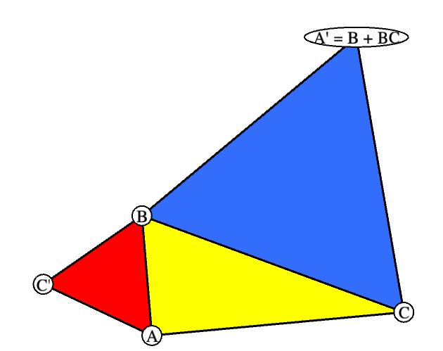
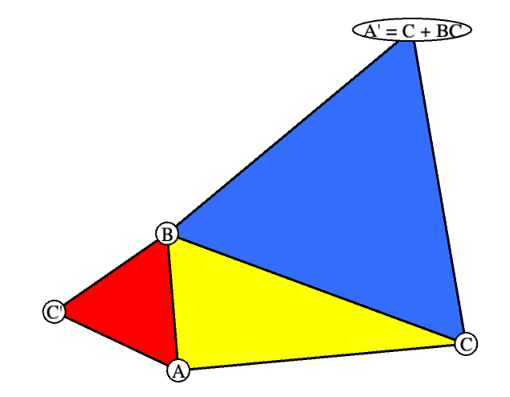
PHSE 2: Solution outline
Next, we make a point A’ which forms an equilateral triangle BCA’. This is because the resultant vectors BC, CA’ and A’B form a 60-degree (π/3 radians) angle with each other.

Slide 12
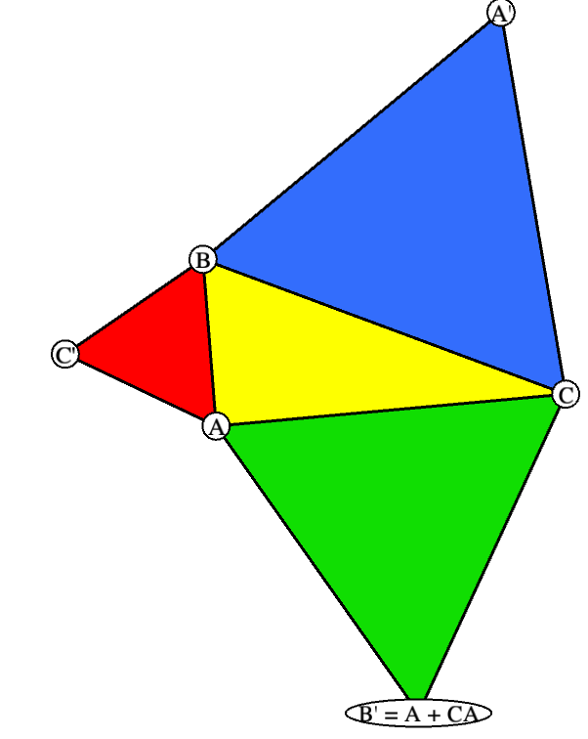
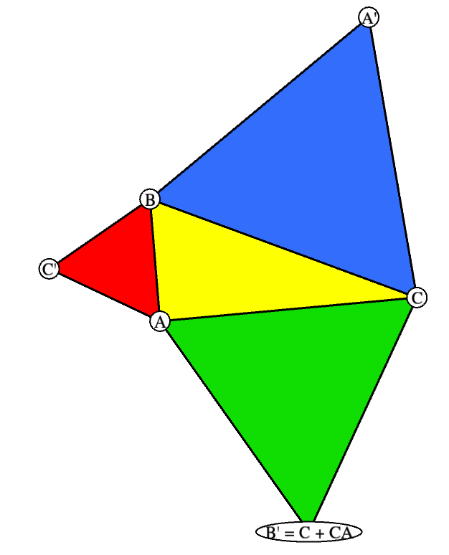
PHSE 2: Solution outline
Next, we make a point B’ which forms an equilateral triangle ACB’. This is because the resultant vectors AC, CB’ and B’A form a 60-degree (π/3 radians) angle with each other.

Slide 13
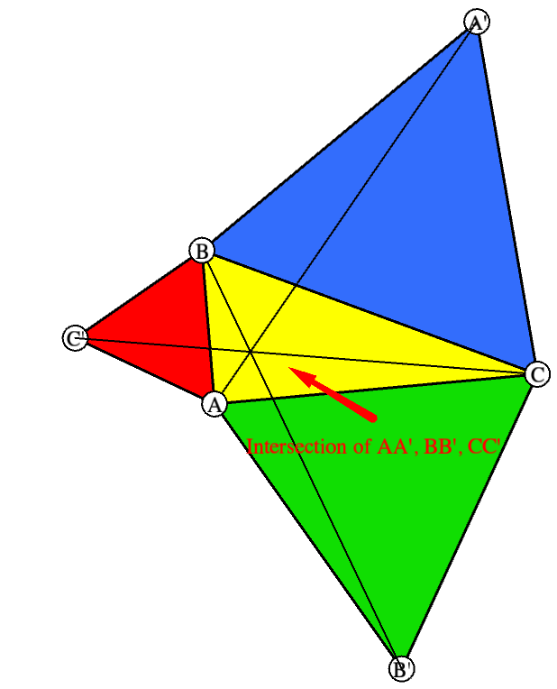
PHSE 2: Solution outline
Finally, we draw lines from each new vertex to the opposite vertex of the original triangle. So we get lines AA’, BB’ and CC’.
The point of intersection that is formed here is the required Fermat point.

Slide 14
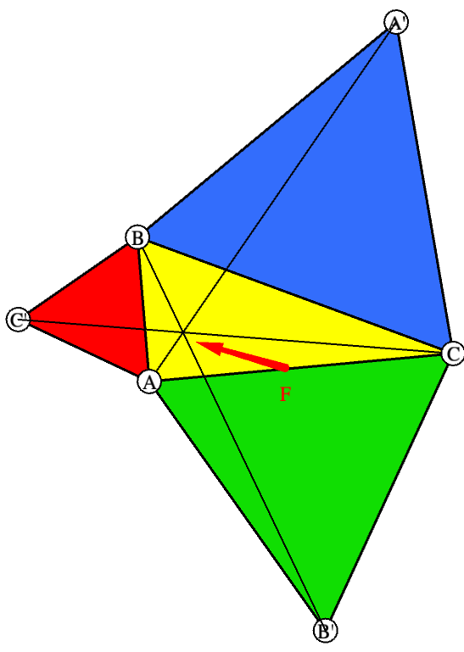
PHSE 2: Solution math
The point F formed by the intersection of the apexes of the created equilateral triangles and their opposite vertices is the Fermat point of the triangle ABC.
JUSTIFICATION:
We know that for F to be the Fermat point, the following must be true:
AF + BF + CF = Minimum possible distance

Slide 15
PHSE 2: Solution math
Here, let our origin be the point F. Since our three constructed triangles are equilateral, we have ∠BFA = ∠AFC = ∠CFB = 120 degrees (2π/3 radians).
Now, consider a point in the plane X. Let a = VCT A, b = VCT B, c = VCT C and x = VCT X and i, j, k be the unit vectors along a, b and c.

Slide 16
PHSE 2: Solution math
Due to this, we get:
|a| = a * i = (a – x) * i + x * i ≤ |a – x| + x * i
|b| = b * j = (b – x) * j + x * j ≤ |b – x| + x * j
|c| = a * k = (c – x) * k + x * k ≤ |c – x| + x * k
Noting that i + j + k = 0 and adding, we see that:
|a| + |b| + |c| ≤ |a – x| + |b – x| + |c – x|,
OR
AF + BF + CF ≤ AX + BX + CX
Thus, the origin or point F is the desired point.

Slide 17
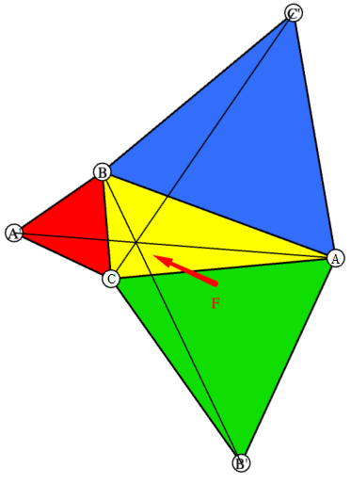
PHSE 2: Solution examples and limitations
My solutions works for clockwise and counterclockwise orientations of the initial points A, B, C. The Fermat point calculated is the same regardless.

Slide 18
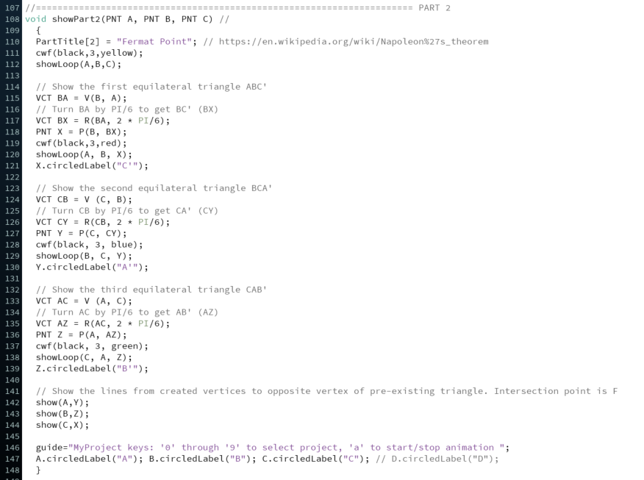
PHSE 2: Code

Slide 19
PHSE 2: Code (Continued)

Slide 20
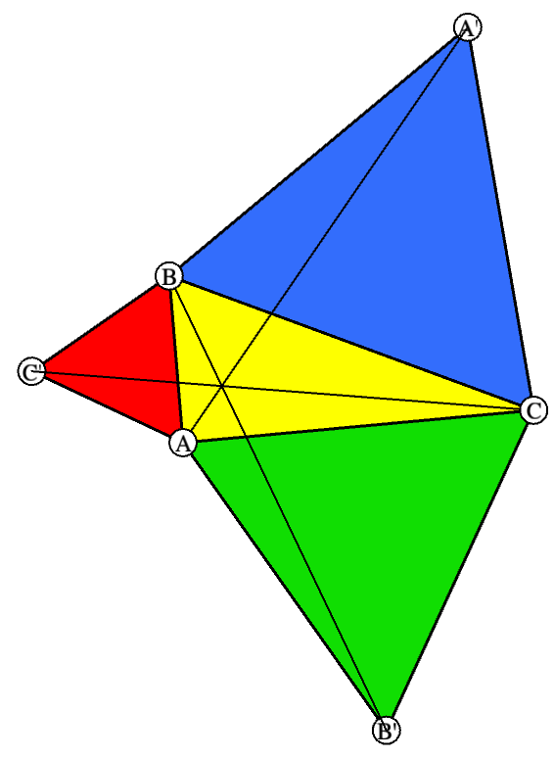
PHSE 2: Code
The code from the previous slide outputs the following:

Slide 21
PHSE 2: Sources
My solution is based on my own previous knowledge of equilateral triangles.
I researched on Fermat points from https://en.wikipedia.org/wiki/Fermat_point
From here, I derived:
Fermat Point is a point such that the total distance from the three vertices of the triangle to the point is the minimum possible.
The Fermat point of a triangle with largest angle at most 120° is simply its first isogonic center or X(13), which is constructed as follows:
Construct an equilateral triangle on each of two arbitrarily chosen sides of the given triangle.
Draw a line from each new vertex to the opposite vertex of the original triangle.
The two lines intersect at the Fermat point.
I also used http://jwilson.coe.uga.edu/EMAT6680Fa07/Shih/AS06/WU06.htm for reference.

Slide 22
PHSE 3: Problem statement
Describe the problem in your own words.
COMMENTS:
Add your comments explaining possible ambiguities and state and justify your assumptions

Slide 23
PHSE 3: Solution outline
Provide concise outline of your approach in plain English .
Use bullets if appropriate
Use images from your code or hand drawn to help the reader

Slide 24
PHSE 3: Solution math
Provide math for your constructions.
Insert figures as needed to clarify
JUSTIFICATION:
Provide concise outline
Use bullets if appropriate
Use images from your code or hand drawn to help the reader

Slide 25
PHSE 3: Solution examples and limitations
State limitations of your solutions.
Insert figures as needed to illustrate

Slide 26
PHSE 3: Code
Paste an image of your code showing line numbers.

Slide 27
PHSE 3: Sources
List and provide links or bib references to all sources of inspiration that you have consulted and used or find useful.

Slide 28

Symbols
! ¬ ∀ ∃ Ω ∅ ∅∈∉⊂⊃∩∪⋂⋃ ≡ ≔ := => → ←↓↑⇒⇨⬄  ◻→
- –— ± ≠ ƒ ≈ ~ ≤ ≥ \ V⁄2 @ √ ∫ ∑ ∏ π αβδϵηγλμνωϕΨ ℓ ∂ µ ß e ẋ ∞ ¶ ⨂⨁⨀∼ ∪ ∩ ∖ ⊗ ∈ ∉ ⊤⊥ ∛
$\vec{V}$ $\vec{v}$ $\vec{AB}$UˆVºV˚Vw U•V M·V  ø U∨V ‖ ∇ ∆ V⊤ V⊥V∠∠
P”(t) P˙ P¨, T₀=A₀B₀C₀ ¯ ‹g›
 $∇$ ∆  ^•○ ◊⁄‹›ˆ ˜ ¯ 〖U〗⟨U⟩
!$      ◻ ⓪①  @§ ①   ☺☹ ⓪①②③④⑤⑥⑦⑧⑨⑩▪⌣≍≅@∴(therefore) ∵(because)
𝔸 𝔹 ℂ 𝔻 𝔼 𝔾 ℍ 𝕀 𝕁 𝕂 𝕃 𝕄 ℕ 𝕆 ℙ ℚ ℝ 𝕊 𝕋 𝕌 𝕍 𝕎 𝕏 𝕐 ℤ
𝕒 𝕓 𝕔 𝕕 𝕖 𝕗 𝕘 𝕙 𝕚 𝕛 𝕜 𝕝 𝕞 𝕟 𝕠 𝕡 𝕢 𝕣 𝕤 𝕥 𝕦 𝕧 𝕨 𝕩 𝕪 𝕫
𝔞 𝔟 𝔠 𝔡 𝔢 𝔣 𝔤 𝔥 𝔦 𝔧 𝔨 𝔩 𝔪 𝔫 𝔬 𝔭 𝔮 𝔯 𝔰 𝔱 𝔲 𝔳 𝔴 𝔵 𝔶 𝔷
𝔄 𝔅 ℭ 𝔇 𝔈 𝔉 ℌ ℑ 𝔍 𝔎 𝔏 𝔐 𝔑 𝔒 𝔓 𝔔 ℜ 𝔖 𝔗 𝔘 𝔙 𝔚 𝔛 𝔜 ℨ
𝒜 ℬ 𝒞 𝒟 ℰ ℱ 𝒢 ℋ ℐ 𝒥 𝒦 ℒ ℳ 𝒩 𝒪 𝒫 𝒬 ℛ 𝒮 𝒯 𝒰 𝒱 𝒲 𝒳 𝒴 𝒵
𝒶 𝒷 𝒸 𝒹 ℯ 𝒻 ℊ 𝒽 𝒾 𝒿 𝓀 ℓ 𝓂 𝓃 ℴ 𝓅 𝓆 𝓇 𝓈 𝓉 𝓊 𝓋 𝓌 𝓍 𝓎 𝓏

